Slide 1
Project C.A.S.P.
Week 5, 2/27/2017
Ryan Tedeschi
Dylan Carson
Chris Bowlen

Slide 2
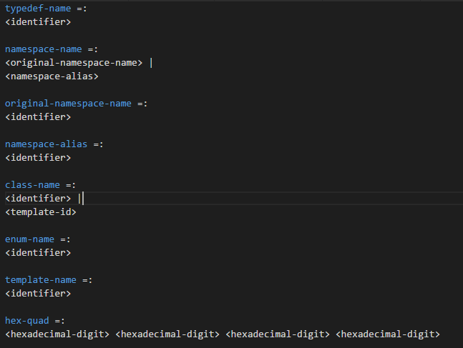

Slide 3
Iterative Analysis
If More Tokens
No
Yes
Finalize Analysis
If For Loop
Calculate Number of iterations, add to Analysis
Yes
No
If While Loop Or Do While loop
Attempt to find number of iterations, add to analysis
Yes
End
No
If Function
Iterative Analysis (function)
Yes
No

Slide 4
DEVELOPMENT progress
Control module almost completed
Parsing Context Free Grammar file
Almost parsing simple argument: int i = 0;
Development on Analyze module started, flowchart constructed
Setbacks: Team illness

Slide 5
Weekly Tasks
Dylan - implementing and testing analyze module
Testing loop checks and the data returned
Ryan – Complete Control module, start outline module
Chris – Translate module

